Slide 1

Neural Network

Slide 2
Detail about Rossman Dataset
Overview
Rossmann operates over 3,000 drug stores in 7 European countries. Rossmann store managers were tasked with predicting their daily sales for up to six weeks in advance. Store sales are influenced by many factors, including promotions, competition, school and state holidays, seasonality, and locality.
Data with historical sales data for 1,115 Rossmann stores. The task is to forecast the "Sales" column for the test set.
Files
train.csv - historical data including Sales
test.csv - historical data excluding Sales
sample_submission.csv - sample submission file in the correct format
store.csv - supplemental information about the stores
Major Data fields
Id - an Id that represents a (Store, Date) duple within the test set
Store - a unique Id for each store
Sales - the turnover for any given day (this is what you are predicting)
Customers - the number of customers on a given day
Open - an indicator for whether the store was open: 0 = closed, 1 = open
StateHoliday - indicates a state holiday. a = public holiday, b = Easter holiday, c = Christmas, 0 = None
SchoolHoliday - indicates if the (Store, Date) was affected by the closure of public schools
StoreType - differentiates between 4 different store models: a, b, c, d
Assortment - describes an assortment level: a = basic, b = extra, c = extended
CompetitionDistance - distance in meters to the nearest competitor store
CompetitionOpenSince - gives the approximate year and month of the time the nearest competitor was opened
Promo - indicates whether a store is running a promo on that day
Promo2 - Promo2 is a continuing and consecutive promotion for some stores: 0 = store is not participating, 1 = store is participating
Promo2Since[Year/Week] - describes the year and calendar week when the store started participating in Promo2
PromoInterval - describes the consecutive intervals Promo2 is started

Slide 3
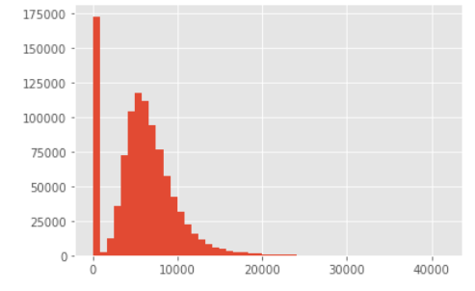
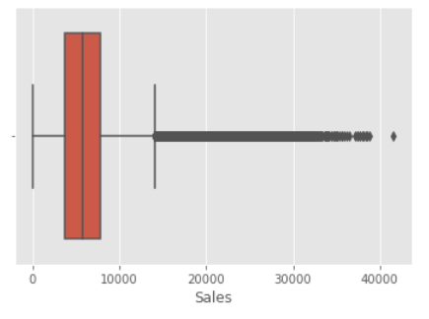
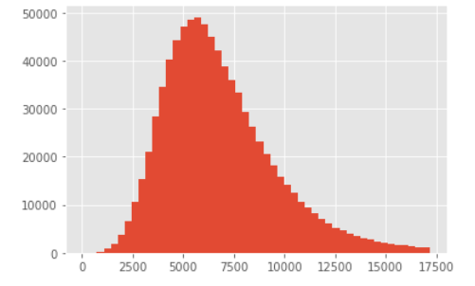
Analysing the column to be predicted
Sales
Histogram plot for sales
The plot has nearly normal distribution but slightly skewed towards the right. Below Steps could lead to Better distributed Data.
Discarded any rows that had Zero sales ( as that can be directly concluded if the store was open or closed).However, we would want our neural network to predict Zero Sales as well.
If we discarding any rows that have sales more than 99 Percentile of value in this case its 17160 , we would get a Normal distribution. However, we would loose much important information about sales which belonged to 1 percentile region.
However, we would loose much important information about sales like High or Zero Sales which our model wont learn if we discard the data. Hence, we included all the sales values
Box Plot showing the outliers
If we keep only 99 percentile of Sales Data

Slide 4
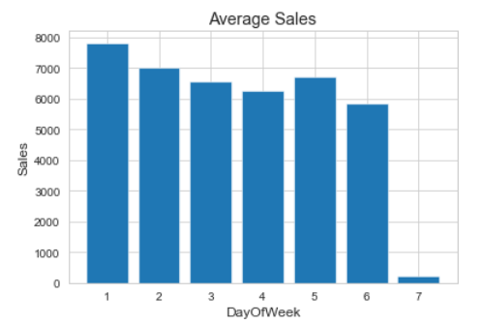
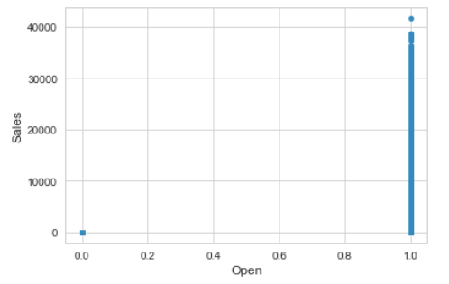
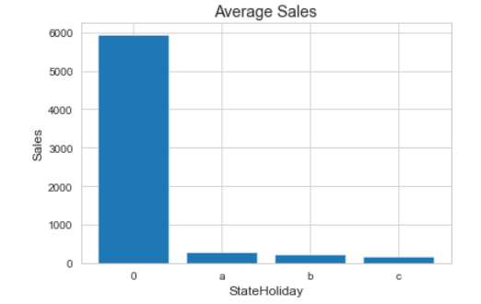
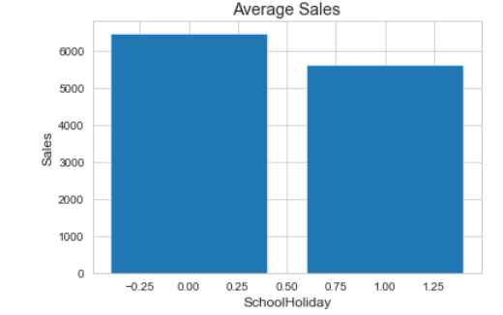
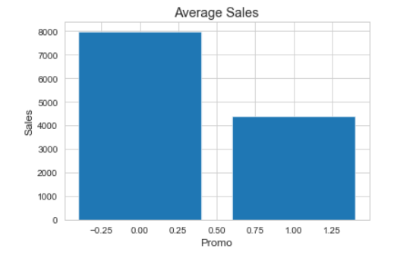
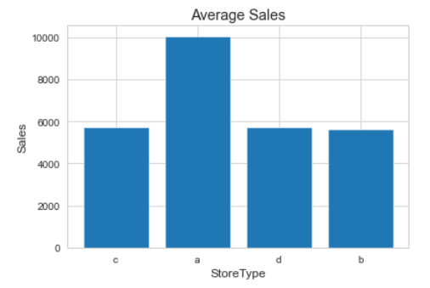
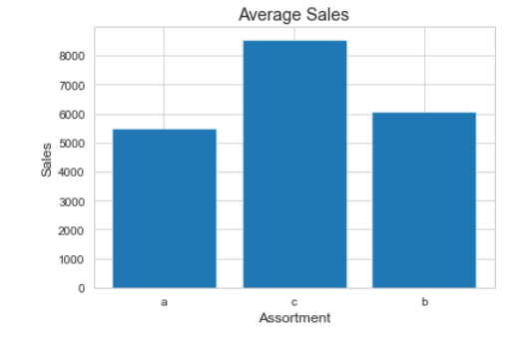
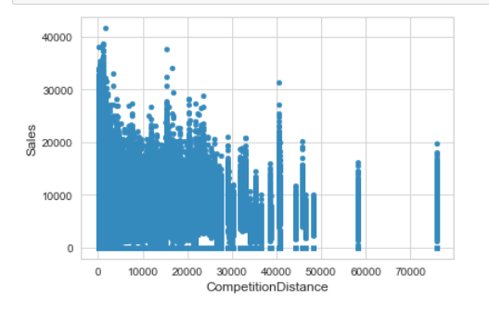
Sales & other Input Features
Sales is highest on Monday and decreases gradually over the week. Most of the stores are closed on Sunday which is clearly visible in sales volume
As Stores are closed The Average sales is 0
Most of the Stores are closed on state holiday, Which affect the sales. Hence sales on Non-Ste holiday’s is higher
Average Sales is slightly higher when there is no school holiday than to other Days
Average Sales is higher where promo is open than to other Days
Average Sales for Store type B is more than any other Store Type
Average Sales for Assortment Type C has more sales than others
There is not much Co relation of Sales with Competition Distance

Slide 5
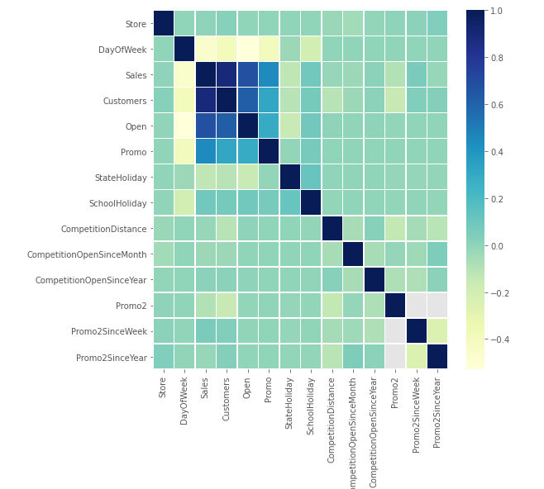
Features Co-relation chart
This plot shows the co-relation between the features as well as with the target variable.
We can see that there is a strong co-relation between the Sales and customers, open , promo.
There is a strong inverse relationship of sales and Dayofweek.
Rest all doesn’t have much co-relation with Sales

Slide 6
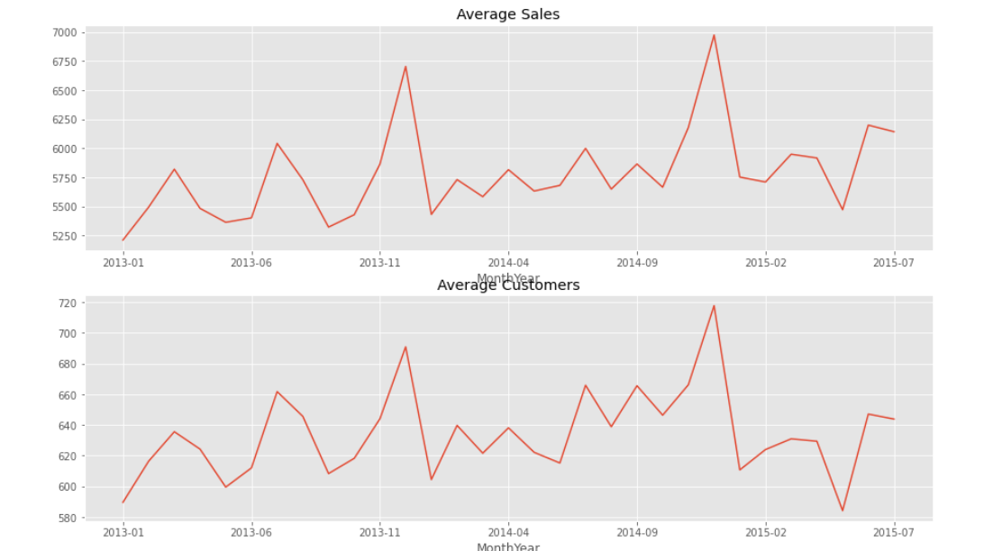
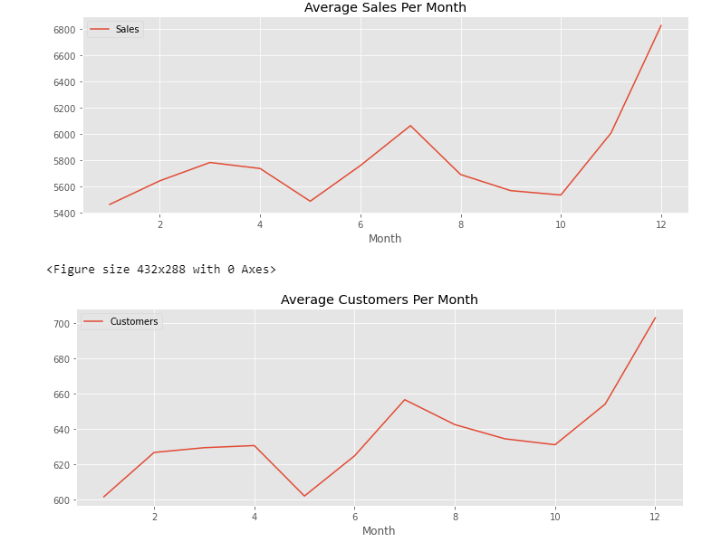
Average sales & customers by Month-Year
We could see that the graph for average sales is similar to average customer. It would be easier to make sales prediction with the help of number of customer information
Hence, we replaced total customer with average customer based on store in training Data.
Also, we have added an extra column of average customers for each stores to test data based on the training values. This will help us to make better prediction.

Slide 7
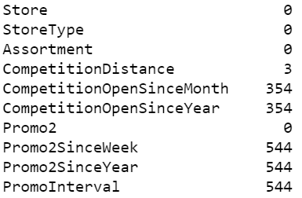
Data pre-processing
Store Data
Competition Distance :
There are 3 null values in competition Distance . We replaced it with the median value . As the data is skewed and has many outliers we did not use mean here.
CompetitionOpenSinceMonth & CompetitionOpenSinceYear :
Initially we filled all NA in CompetitionOpenSinceYear and CompetitionOpenSinceMonth with 1800 and 1 respectively.
There were two Outliers in CompetitionOpenSinceYear ( 1900 and 1961), we replaced those with 1800 as well.
Promo2SinceWeek, Promo2SinceYear and PromoInterval
We filled all NA for Promo2SinceYear with 1800, Promo2SinceWeek with 1 and PromoInterval with 0
Count for null values

Slide 8
Feature Engineering
New Columns Added
Year, Month, Day :
Have added these columns based on date column. Then have applied one hot encoding for these columns
CompetitionOpenSince:
based on the CompetitionOpenSinceYear and CompetitionOpenSinceMonth we get the relative Days for which competition has opened.
Promo2Days:
based on the Promo2SinceYear and Promo2SinceWeek, we get the relative Days for which Promo is open
StoreType, StateHoliday, Assortment & PromoInterval
Applied one hot encoding for these columns
StateHoliday:
have changed all values of Stateholiday except 0 to 1. Average Sales during different state holidays are nearly same
Customers:
Calculated average customer per store for all days of week to add it to the whole data set (train and test) to make better predictions
Columns Dropped:
Date
CompetitionOpenSinceYear
CompetitionOpenSinceMonth
Promo2SinceYear
Promo2SinceWeek

Slide 9
Columns used in the Model
Columns before one hot encoding : 19
Store, DayOfWeek, Date, Sales, Open, Promo, StateHoliday, SchoolHoliday, StoreType, Assortment, CompetitionDistance, Promo2, PromoInterval, Customers, CompetitionOpenDays, Promo2Days, Day, Month, Year
Columns After one hot encoding (StoreType, StateHoliday, Assortment, PromoInterval, day, month & year) : 68
Store, DayOfWeek, Date, Sales, Open, Promo, StateHoliday, SchoolHoliday, CompetitionDistance, Customers, CompetitionOpenDays, Promo2Days, Assortment_a, Assortment_b, Assortment_c, PromoInterval_0, PromoInterval_Feb_May_Aug_Nov, PromoInterval_Jan_Apr_Jul_Oct, PromoInterval_Mar_Jun_Sept_Dec, StoreType_a, StoreType_b, StoreType_c, StoreType_d, Day_1, Day_2, Day_3, Day_4, Day_5, Day_6, Day_7, Day_8, Day_9, Day_10, Day_11,Day_12, Day_13, Day_14, Day_15, Day_16, Day_17, Day_18, Day_19, Day_20, Day_21, Day_22, Day_23, Day_24, Day_25, Day_26, Day_27, Day_28, Day_29, Day_30, Day_31, Month_1, Month_2, Month_3, Month_4, Month_5, Month_6, Month_7, Month_8, Month_9, Month_10, Month_11, Month_12, Year_2013,Year_2014, Year_2015
After feeding this to time series function, we have all these columns for past 4 days. Hence our final column is total 280 columns in training data set . However, before feeding to LSTM. We convert the data to 3D matrix, each records will have [5][68] features

Slide 10
Data Normalization
Min-Max Scaler
Have used MinMax Scalar from SkLearn.
x = [(value - min)/(Max- Min)]
Had tried standard scaler. However, we got higher error values in LSTM than Min-Max scaler
Why Not Standard Scaler ?
In standard scaler each feature is scaled to certain range based on its mean & standard deviation, which might create issue in our neural network as some inputs due to higher magnitude might get more weightage than others.
Standard Scaler can be used if the data follows normal distribution
Standard scaler is affected to outliers

Slide 11
Custom Timeseries Function
Problem Statement:
This Dataset has Sales details for 1116 stores over a period. As there are Many stores involved and each store can have its own pattern of sales. The Data cannot be directly considered as timeseries. For a record if we take n past days data , we would be considering all the stores data irrespective of which ever store that record belongs to. Even if we consider all the stores as one, if we take a record , we would get many records for a single day which is not recommended for LSTM.
Solution:
If we consider all records for a store , then we can use the previous Days Data in order to make predictions.
Hence, we have come up with logic to convert this Data to time Series
For a store :
we fetch N past days data records with S sampling rate and create new columns for each features.
We do this for all the stores.
We have Considered 4 past days with sampling rate as 1
For Instance , for a store 1009 for 20/01/2015 record , we take 16th to 19th Jan details of store 1009 and add new columns to 20th Jan records. Then we convert this data to 3D Matrix (each records will have [5][number of Features] records

Slide 12
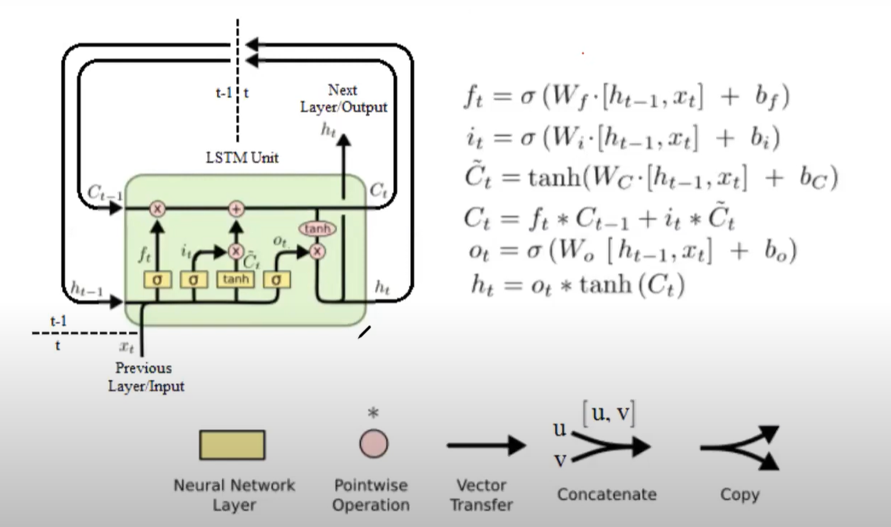
LSTM
Long short-term memory (LSTM) is an artificial recurrent neural network (RNN) architecture used in the field of deep learning. Unlike standard feedforward neural networks, LSTM has feedback connections. It can process entire sequences of data. LSTM are a special kind of RNN, capable of learning long-term dependencies.
The advantage of an LSTM cell compared to a common recurrent unit is its cell/memory unit. The cell vector can encapsulate the notion of forgetting part of its previously stored memory, as well as to add part of the new information.
A common LSTM unit is composed of a cell, an input gate, an output gate and a forget gate.
Cell/Memory Unit
The cell remembers values over arbitrary time intervals and the three gates regulate the flow of information into and out of the cell.
In the First Step it decides what information to forget based on current input and previous output. This is done with the help of forget gate
In the next step It decides what new information needs to be stored in the cell state. This has two parts. First input gate layer decides which values to update. Next, a tanh layer creates a vector that could be added to the state.
Output Unit
First a sigmoid layer takes the input and previous output as input.
Then Tanh Is applied to the cell state and multiply it by the output of the sigmoid gate

Slide 13
Dropouts
Dropouts refers to dropping out units (both hidden and other layers) in a neural network.
Why do we need dropout ?
To prevent over-fitting by regularization
A fully connected layer occupies most of the parameters, and hence, neurons develop co-dependency amongst each other during training which curbs the individual power of each neuron leading to over-fitting of training data.
It behaves like weight decay. It doesn’t let the NN to put much weight on any neuron.
Regularization reduces over-fitting by adding a penalty to the loss function. By adding this penalty, the model is trained such that it does not learn interdependent set of features weights.
Hence, we randomly drop some percentage of neurons

Slide 14
Batch Normalization
Batch Normalization is done between the layers of Neural network in order to Normalize the output of previous layer to speeds up learning and leads to faster convergence.
Batch Normalization layer will transform inputs so that they are standardized, meaning that they will have a mean of zero and a standard deviation of one.
During training, the layer will keep track of statistics for each input variable and use them to standardize the data.
The statistics used to perform the standardization, e.g. the mean and standard deviation of each variable, are updated for each mini batch and a running average is maintained.

Slide 15
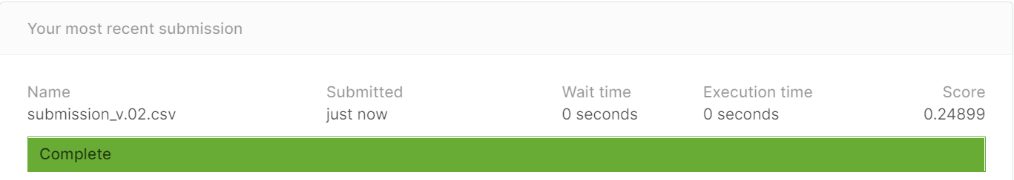
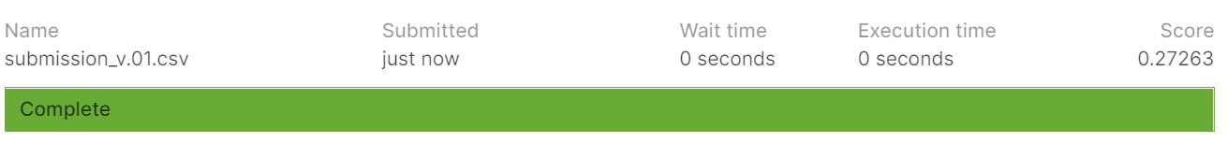
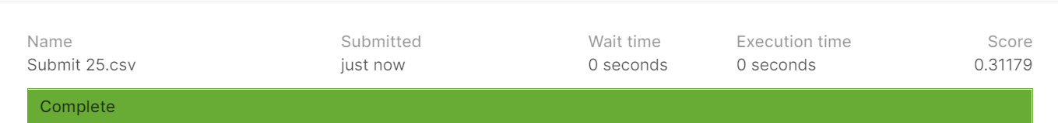
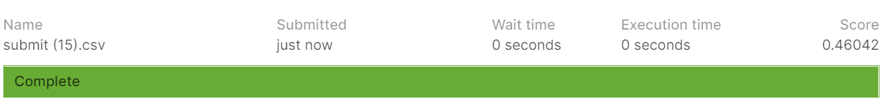
Final Model
We have Considered 3 layers of LSTM and 3 Layers of Dense Layers along with few layers of Dropouts and batch normalization.
We have researched on many different combinations of models and by far this gave the best results
Result obtained By This Model
Result obtained By Other Models
1. 5 layers of LSTM Model
2. 10 layers of Dense Model
3. 4 Layers of LSTM with Keras Timeseries Generator

Slide 16
Conclusion
We as a team have researched on many model that would be appropriate for the data.
As the Dataset was not proper timeseries, we converted it to time series data using our own custom made functions in order to achieve less error.
We have used LSTM along with Dense Layers as our Final model.
The error which we get in the portal is 0.24899
It was a great learning experience for us , to come up with the best model, we had to read many research papers and blogs in order to get in depth knowledge of the Deep Neural Network.

Slide 17
References
Ian Goodfellow ,Yoshua Bengio & Aaron Courville, Deep Learning - Adaptive Computation and Machine Learning, 2015
Jason Brownlee’s Blog, How to Accelerate Learning of Deep Neural Networks With Batch Normalization, machinelearningmastery.com/

Slide 18
Additional Slides

Slide 19
Time Series Generator
LSTM network captures time-series patterns, we can build such a model with the input being the series of past data with uniform intervals.
We have used TimeseriesGenerator Provided by Keras in our Model.
This function takes in a sequence of data-points gathered at equal intervals, along with time series parameters such as length of the sequences/windows, spacing between two sequence/windows, etc., to produce batches of timeseries inputs and targets.
Suppose,
Total Rows : 675470
Total Features is 27
Input Matrix dimension = 675470 * 27
If we apply timeseries on it
TimeseriesGenerator(x_train,y_train,length=past_days, batch_size=512)
It generates a 5d timeseries Matrix
[0 to 1319]
Number of batches =
Total records/Batch size
[0 or 1]
0 = Input
1 = Target/Output
[0 to 511]
Number of records in batch= batch Size
[ 0 to 59]
Number of past Days considered
[0 to 26]
Number of Features
* For Target for Output The Matrix is [0 to 1320] [1] [0 to 511] [0]

